Slide 1
Airbnb - User Journey & Growth Analysis
- A Case Study by Anik Chakraborty

Slide 2
🎯 Objective
Project Purpose:
Analyze user behavior and journey on the Airbnb platform. Identify key drivers of user engagement and booking conversion. Evaluate marketing channel effectiveness and platform usage.
Key KPIs:
Total Unique Users
Total Sessions
Total Bookings
Conversion Rate (%)
Average Session Duration
Average Devices per User
Deliverables:
Interactive Power BI Dashboard Pages
User Journey Overview
Growth Analysis
Actionable business recommendations

Slide 3
📘 Project Overview
Context Highlights:
In a highly competitive digital marketplace, every user interaction—from first visit to final booking. Analyzing these user journeys across devices and channels helps uncover key touchpoints that drive engagement, retention, and conversion.
The insights generated from this analysis help businesses to:
Airbnb operates in a multi-device, multi-channel environment
Users interact via web, mobile, and different acquisition channels
Understanding user journey helps improve:
Conversion rates
User engagement
Marketing ROI

Slide 4
🗂️ Data Overview & Schema
Data Source:
Source: Airbnb User & Session Dataset
Data Type: Structured (Relational Tables)
Time Period: 2010 – 2014
Data Structure & Metrics:
Key Index: user_id
Total Rows: ~100K+ session records
Categories:
User Data: Gender, Signup Method, Device
Session Data: Actions, Duration, Device Type
Marketing Data: Affiliate Channels & Providers
Calculated Metrics:
Conversion Rate (%)
Session Engagement Rate
Average Session Duration
Average Devices per User
Total Time Spent per User

Slide 5
💻 Tech Stack
Tools:
SQL
Data extraction & business question analysis
PowerQuery
Data Transformation & Shaping
Column Standardization
Data Preparation for BI Integration
PowerBI
Dashboard & Visualization
Data Modeling & Relationship Building
DAX – KPI Calculations Columns & Measures
Slicers & Dynamic Filtering
PowerPoint
Presentation and final dashboard snapshots

Slide 6
📈 Methodology & Analysis
Preparation, Process & Analytical Approach:
Data Preparation & Cleaning:
Handled missing values (e.g., gender, country)
Standardized device types & signup apps
Removed inconsistencies in session data
Data Modeling & Integration:
Joined users and sessions tables
Created unified dataset: countries_users_sessions
Feature Engineering:
Booking Status (Booker vs Looker)
Session Engagement Rate
Conversion Rate
Device Usage per User
Visualization Design:
Built two interactive Power BI dashboards
Used clear KPI cards & supporting visuals
Consistent color theme & layout
Validation & Formatting:
Cross-validated SQL results with Power BI
Applied percentage formatting & clean labeling

Slide 7
❓ Problem Statement
Understanding how users interact with the platform at each stage of their journey is crucial to identifying friction points and unlocking growth opportunities. These questions form the foundation of a data-driven approach to evaluate user behavior and support strategic decision-making.
Therefore, this analysis focuses on the key drivers of user behavior, engagement, and conversion.
Key Questions:
Who are the users and how do they interact with Airbnb?
Which devices and platforms drive engagement?
Which marketing channels bring the most users?
Which channels convert users into bookings?
Who are the most valuable and active users?
How does user behavior impact conversion?

Slide 8
💡 Key Insights
Top Findings:
~41% overall conversion rate indicates strong booking performance
Desktop is the dominant entry device for users
Direct channel contributes the highest number of users and bookings
Mobile App shows higher conversion rate compared to Mobile Web
Multi-device users show higher engagement levels
A small group of users contributes disproportionately to session activity
Supporting Metrics:
Total Users: 2,500
Total Bookings: 1,035
Conversion Rate: 41.40%
Avg Session Duration: ~1,098 seconds
Top Channel: Direct (~70%+ contribution)

Slide 9
📍Conclusion
Summary:
User behavior is strongly influenced by device type and entry channel.
Direct and organic channels are key drivers of growth.
Mobile platforms offer strong conversion opportunities.
High-engagement users are critical for platform success.
Optimizing user journey can significantly improve conversion rates.

Slide 10
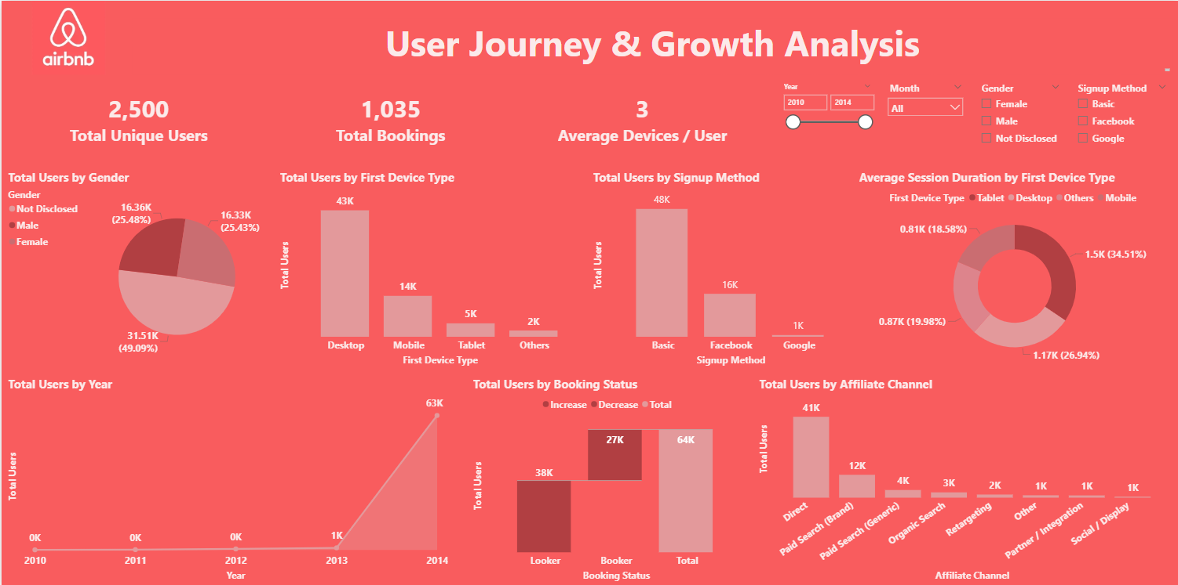
🖥️ Dashboard Overview (1) – User Journey Overview

Slide 11
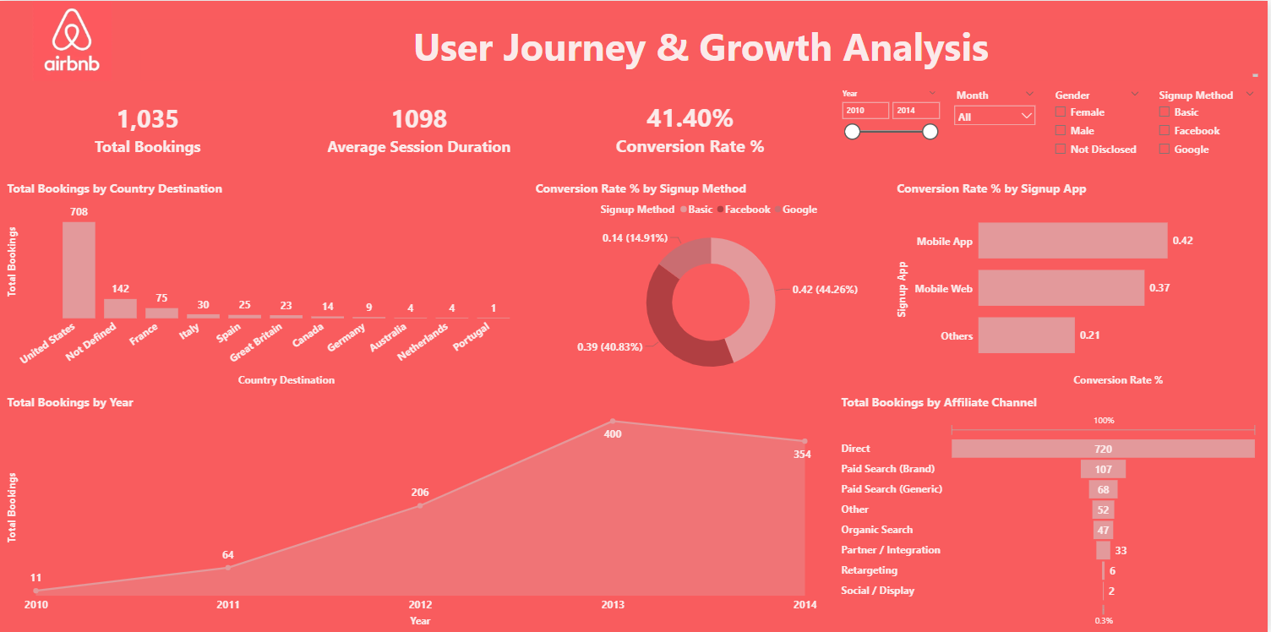
🖥️ Dashboard Overview (2) – Growth Analysis

Slide 12
✅ Business Impact & Use Cases
This project demonstrates how transforming user data into actionable insights helps uncover behavior patterns, enabling smarter decision-making, optimizing user experience, and driving engagement, conversion, and sustainable business growth. Insights generated from this dashboard support data-driven strategy decisions.
Marketing Optimization:
Identify high-performing channels and reallocate budget to maximize ROI while reducing acquisition costs.
Channel Growth Strategy:
Scale high-conversion channels and replicate successful acquisition strategies to drive sustainable growth.
User Experience Enhancement:
Improve mobile and platform experience by reducing friction and increasing user engagement.
High-Value User Targeting:
Focus on high-intent and high-engagement users to boost retention and maximize lifetime value.
Conversion Improvement:
Optimize key touchpoints in the user journey to reduce drop-offs and increase booking rates.
Data-Driven Decisions:
Leverage insights to align product, marketing, and business strategies with actual user behavior

Slide 13
🙏 Acknowledgement & Contact
Project Analyst: Anik Chakraborty 📧 Email: anikc1710@gmail.com
Special Thanks To:
Coding Ninjas – for project framework and guidance
Connect: 🔗 GitHub | 🔗 LinkedIn

Slide 14
Thank You!

